Slide 1
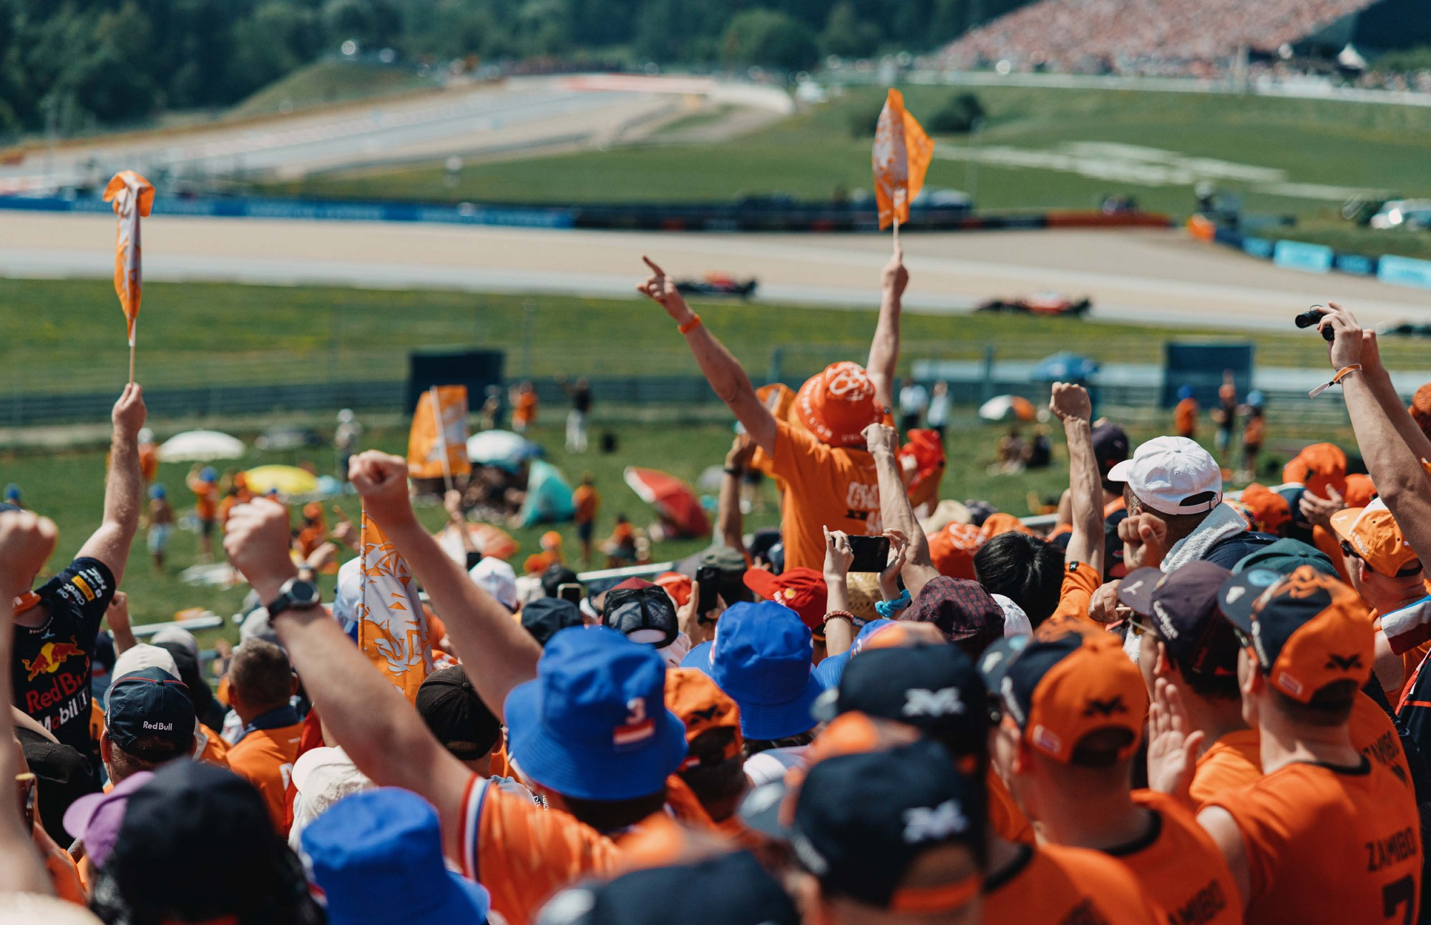
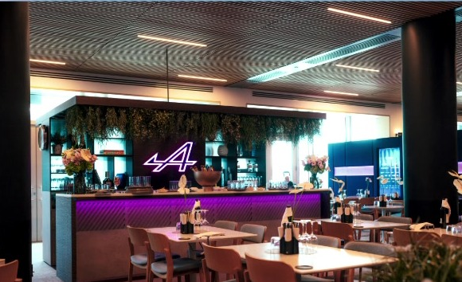
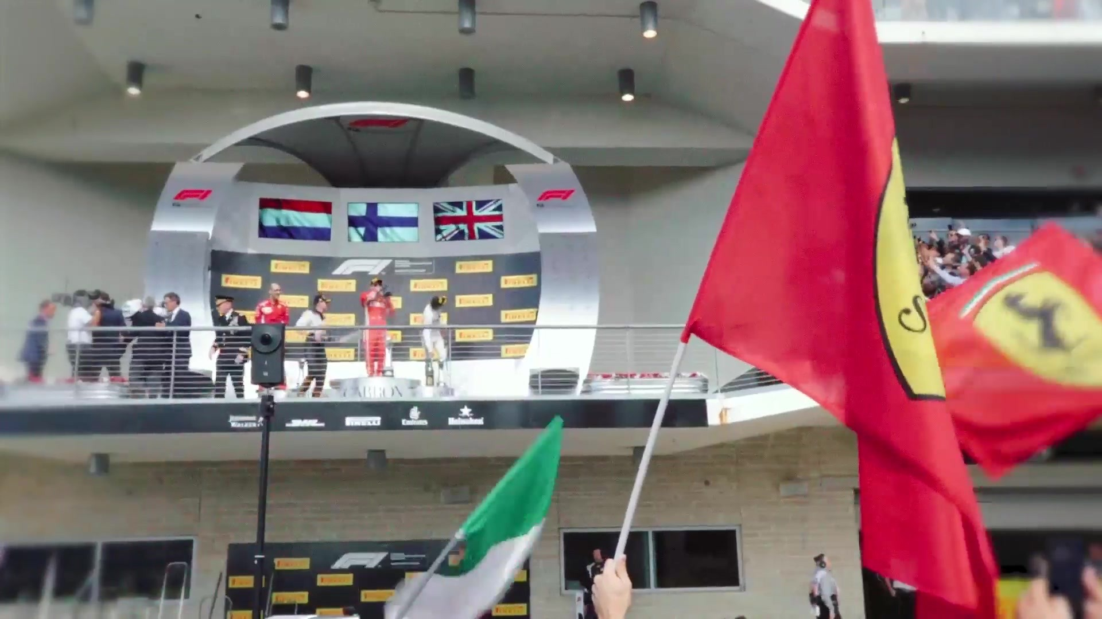



Hospitality is how F1 pays for itself: retention, pipeline, new merchants
Why F1 · Hospitality · Adyen in F1 · The routes · Next steps
F1 PAYS FOR ITSELF
Max Verstappen · Orange Army grandstand
Alpine F1 Team · the Alpine Lodge
Scuderia Ferrari · fans at the podium
CLIENT RETENTION
PIPELINE GENERATION
MERCHANT ACQUISITION
Exclusive experiences
Bonds with clients that traditional hosting cannot match.
A qualified audience
C-suite decision-makers, in market, at every race.
A network of brands
371 partners on the 11 teams' rosters to meet.
1 Host 24 race weekends; clients and prospects in one place
2 Convert Decision-makers, time together: deals move faster
3 Fund Bring today's local hosting budgets into one programme
Source: SPORTFIVE.
Notes:
SCRIPT
This is the part of F1 that pays for itself: hospitality. It does three jobs. It keeps clients, with experiences ordinary hosting can't match. It builds pipeline, because every race puts senior decision-makers in one place, with time to talk. And it brings in new merchants: the teams' 371 partners are all in the paddock.
[Cue: say the next part without showing it. The source material is confidential, so it isn't on any slide.]
You don't have to take our word for the returns. Three partners have measured them.
Komatsu hosts its key global stakeholders at races with Williams; for many of them, it's the first Komatsu event they've ever attended. Komatsu has hosted 3,735 stakeholders. 90% said it was useful for business discussions, 94% were satisfied, and Komatsu has received more than $100 million in orders at races.
HPE has partnered Mercedes since 2018. Their CEO, Antonio Neri, says the real value is being able to show their technology working through Mercedes, and to engage customers directly at races. Looking back over that partnership, in his words: "From race activations alone, we've accelerated over $300 million in revenue opportunity."
And Businessolver, a partner of Alpine: $122 million in business pipeline, influenced by hosting at the track.
The economics are simple. Adyen already spends on hosting, market by market. Pull that into one programme across eight to ten races and the partnership starts funding itself: one budget, one standard, and much more leverage.
Ask Mark: What's a new enterprise merchant worth to Adyen in its first year? Once we know that, we can work out how many the programme has to win to pay for itself.
Ask Mark: And roughly what does Adyen spend on hosting today, and who owns that budget in each market?
Where it's from: partner case material compiled by SPORTFIVE: Komatsu with Williams, HPE with Mercedes, Businessolver with Alpine. Marked confidential, so keep it in the room.
[If Mark asks how long it took them to earn it back:] be precise, because none of the three figures is a payback period. HPE's $300 million is revenue opportunity accelerated over its whole partnership with Mercedes, which started in 2018, so roughly eight seasons; it's opportunity, not booked revenue. Komatsu's $100 million is orders received at races; the material gives no time period, but Komatsu's current Williams partnership began in 2024 and was renewed this year, so it sits within the last few seasons. Businessolver's $122 million is pipeline influenced, not closed business, and also has no period. Say: "The case material doesn't give a payback period; we'll get the exact timeframes for you before you see Peter." Then turn it back to Adyen's own maths: what's one new enterprise merchant worth in year one?
SOURCES AND NOTES
Team deck slide 13, the ultimate B2B platform: exclusive experiences, a qualified audience and visibility with a high-value enterprise buyer universe. 371 partners: SPORTFIVE team partnership network (Nov 2026), the sum of the 11 teams' rosters. 24 race weekends: the 2027 calendar.
Source: SPORTFIVE; SPORTFIVE team partnership network (Nov 2026); F1 2027 calendar. Photos: Max Verstappen × Adyen proposal; Alpine F1 Team presentation; SPORTFIVE hospitality film.

